Slide 1
W209 Midterm Presentation
WASH Project
Team Members: I-Wae Niu, Chloe Wu, Adara Liao, Elle Proust

Slide 2

Overall Project Objectives
Why is WASH important?I
In 2015, 1 in 3 people were without sanitation facilities. In 2016, 1.9M deaths could have been prevented with adequate WASH.
3 interdependent core issues that UNICEF has identified as part of Sustainable Development Goal by 2030
2 Goals of Dashboard
General information on WASH
Tool for NGOs to assess best ROI
Notes:
In 2015 the World Health Organization (WHO) estimated that "1 in 3 people, or 2.4 billion, are still without sanitation facilities" while 663 million people still lack access to safe and clean drinking water.

Slide 3
Introduction
Data from World Bank, covering 140 developing countries
Water: Basic water source within 30mins roundtrip; safely managed water supply (on-plot, continuous and safely managed)
Sanitation: Fixed defecation point (elimination of open defecation point and promotes safe sanitation), safely managed treatment of fecal matter
Hygiene: Handwashing - presence of handwashing station, water and soap
Costs to increase WASH coverage per person, by country, in 2015 and estimates through 2030
Estimated by multiplying the population to be covered by the cost per capita
Split by capital investment, capital maintenance and operations costs
Notes:
Provision of safe drinking-water is a key component of the campaign to eradicate Guinea worm. ā Sanitation prevents soil-transmitted helminth infections and schistosomiasis

Slide 4
Audience
Who does project serve and what are questions?
General Audience
“What is coverage like globally”?
“Which regions and countries lack the basic water, sanitation and hygiene?
NGO
“With my limited funds, where can I maximize the impact of my money?”
“How much should budget should I plan for to build, operate and maintain improvements to WASH?”
Notes:
Provision of safe drinking-water is a key component of the campaign to eradicate Guinea worm. ā Sanitation prevents soil-transmitted helminth infections and schistosomiasis

Slide 5
Visualization Roadmap
1
2
3
4
What is WASH?
What’s
the gap?
Cost to solve?
How to invest?
Audience
General public
General public
Gov’t/policy makers
NGOs/donors
Gov’t/policy makers
NGOs/donors
Gov’t/policy makers
NGOs/donors
Tasks
WASH definition
Sub-pillar definitions
Background/context
Coverage by pillar
No. people affected
Compare/rank at global, region & country
Cost to solve total WASH & by pillar
Compare/rank at global, region & country
No. people impacted per $X donated
Compare/rank at global, region & country
Interaction
Relevant source links
Drill down by global, region & country level
Drill down by global, region & country level
Highlight and/or group countries/regions
Drill down by global, region & country level
User input donation amount

Slide 6
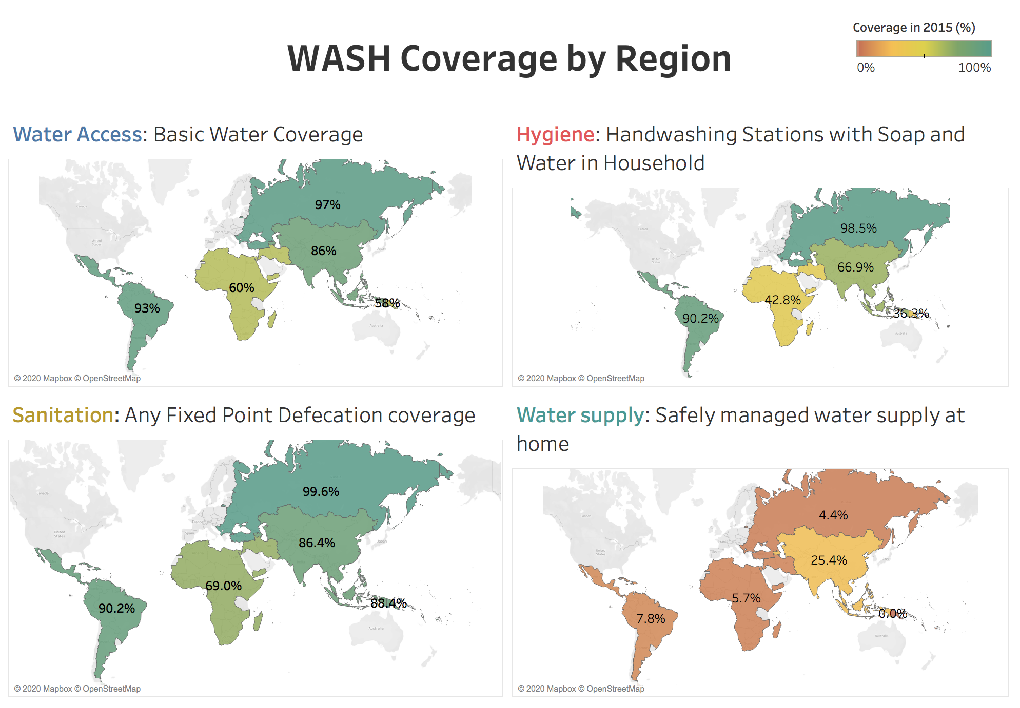
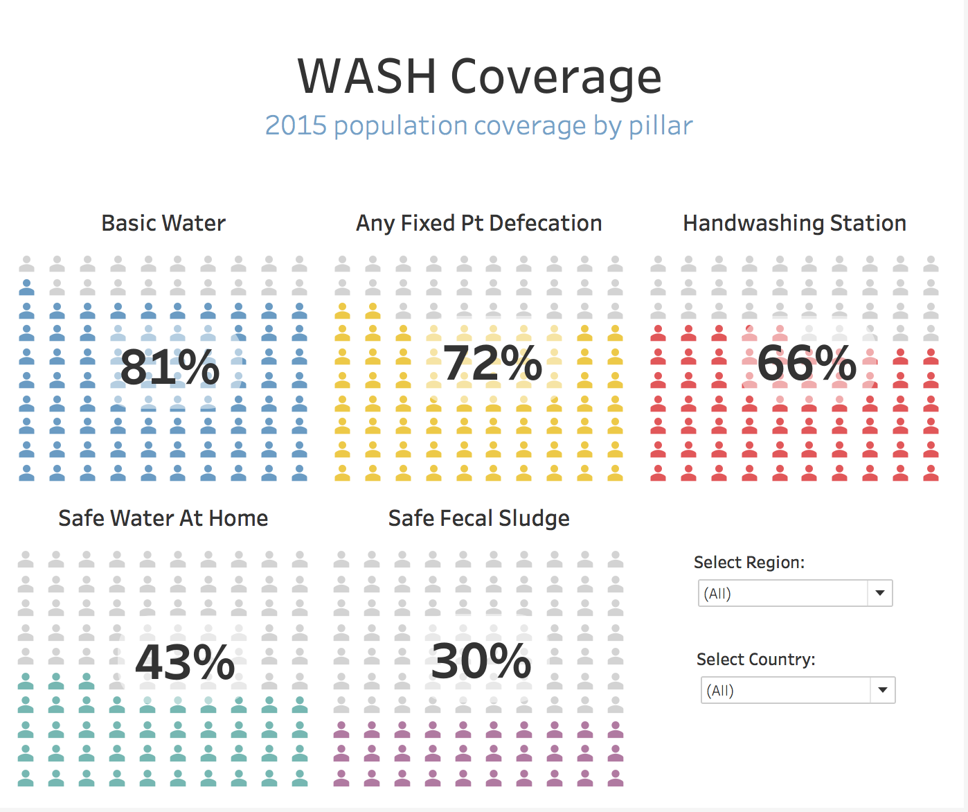
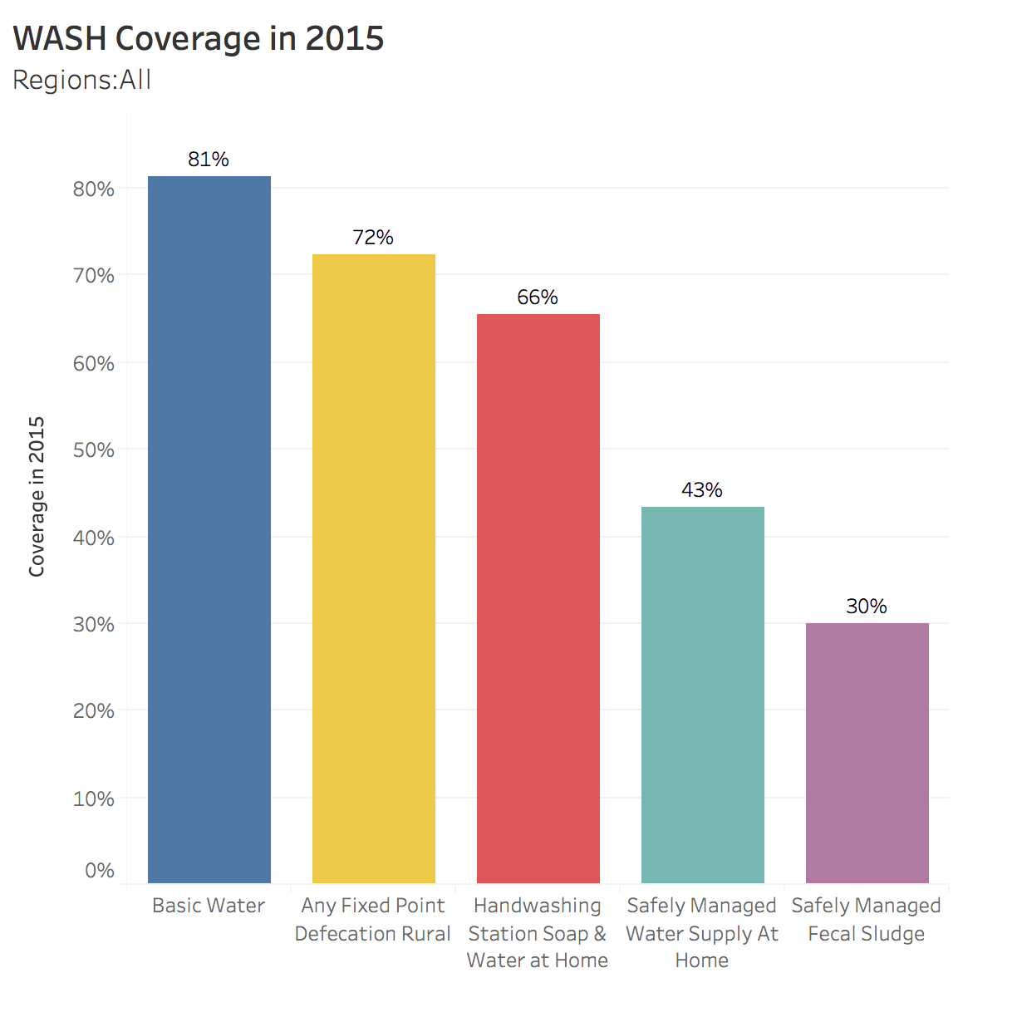
Visualization Walkthrough - Total WASH Overview

Slide 7
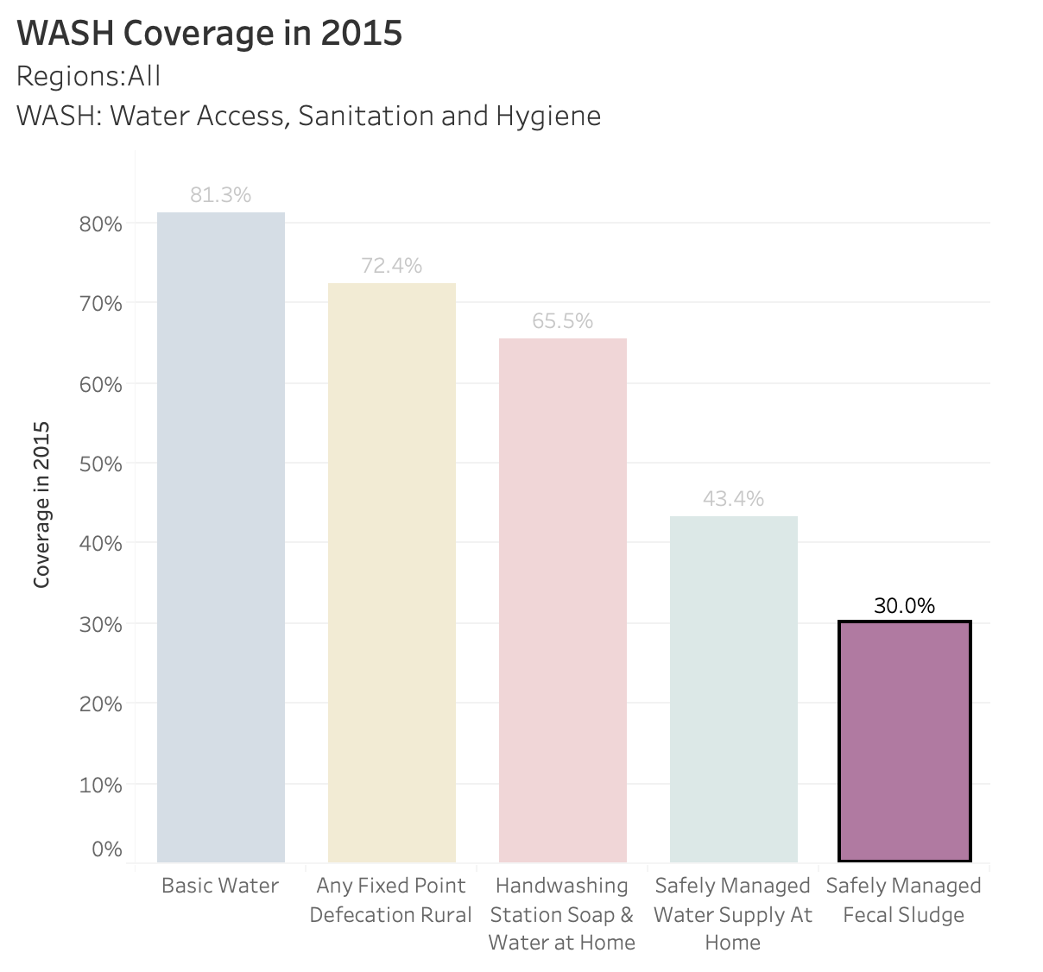
Visualization Walkthrough - Storyline
What is the overall status?
Who has done a good job and who has not?
Where to put your fund to make the greatest difference?
Notes:
“Almost every dollar invested in water and sanitation services yields a return of US$ 5 due to reduced health care costs for individuals and society, and greater productivity”
What aspects of a user-centered design processes are being used? What additional design methods would be helpful for this project?
PPP: purchasing power parity

Slide 8
Costs Summary - “How Can I Help”
Refer Costs Tableau

Slide 9
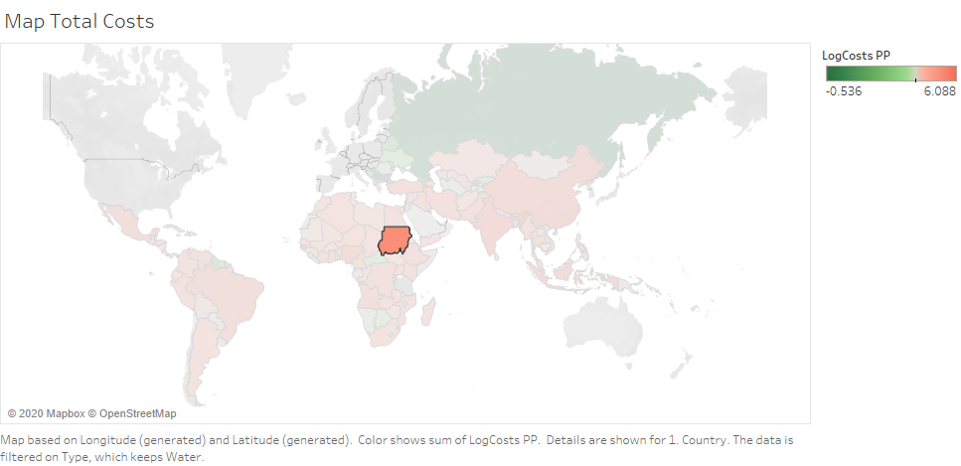

Mockup Final View
Sudan
Measure: Sanitation
Donation: <USER INPUT>
With Sanitation
Helped by your Donation
Without Sanitation

Slide 10
Testing Plan
Who:
3-5X Donors/Effective Altruists (identified perhaps via slack)
Two team members present at each meeting - one to demo and one to record
What:
Exploration checking that the story is clear and easily conveyed
Designed to test whether visualizations are clear
(example question which countries have the lowest rates of access to basic sanitation)
And whether the visualizations aid donation decisions
How:
20 minute video conference with a prototype of visualization

Slide 11
Feedback
adaraliao@ischool.berkeley.edu
ecproust@berkeley.edu
iniu@ischool.berkeley.edu
yzwu@ischool.berkeley.edu

